Slide 1
Strategy on a Page
1
Mission and Purpose
2
3
4
Solution & MVP
Target Audience
Commercial Viability
Only 1,101 out of 1,524 public schools had at least one social worker; of those schools, 80% did not meet the recommended social-worker-to-student ratio of 1:250.
Solution
Students (Ages 13+) attending DOE schools.
DOE Social Workers.
DOE Guidance Counselors.
Other DOE Student Wellness Support Team individuals.
Anticipated Sponsor
A mental health app for public school students (13+), where they can track their emotions, journal their thoughts, and engage in peer-based mindfulness activities. DOE counselors monitor student moods in real-time, providing timely support to improve emotional well-being
The New York City Department of Education
NY National Association of Social Workers
"We are committed to enhancing our school mental health programs to improve school's abilities to provide access and support during the school day."
To improve oversight of public schools’ mental health curriculum and equipping guidance counselors or social workers' with age-appropriate resources they need to support students’ emotional wellbeing.
MVP
Virtual Companion/Chat-Bot
Mini Games
Journaling Tab
Mood Calendar
Mental Health Resources
NYC Department of Education

Slide 2

CUCU: Your Wingman for Mental Well-being!
The Cooper Union
09/13/2024
Pfizer 2024 | Confidential and Proprietary
Notes:
Aaryan

Slide 3
01 Our Team
Introduction to our team of mechanical and electrical engineers
02 Background Research
Statistics about NYC mental health + DOE.
03 Target Audience
NYC DOE Student Wellness Team, Highschool students.
04 Design Process
Initial Brainstorm, algorithms, and UI design.
05 Solution & MVP
Analysis of app's features for both students and administrative members.
06 Mood Classification Algorithm
NLP-based chat-bot, and mood sorting algorithm.
07 Commercial Viability
Why should the DOE invest in our project?
08 Future Work
3 year time-line for next steps of development process.
Notes:
aaryan

Slide 4
Our Team
01
Notes:
aaryan

Slide 5






Our Team
Lizelle Ocfemia
Lamiah Khan
Lei/Raymond Chi
Aaryan Mahipal
Jaehyeon Park
EE’25
EE’26
EE’25
ME’25
ME’26
Notes:
aaryan

Slide 6
Background Research
02
Notes:
aaryan

Slide 7
"In 2021, 38% of the city's high school students reported feeling so sad or hopeless in the past year, compared with 27% in 2011. "
Notes:
aaryan

Slide 8
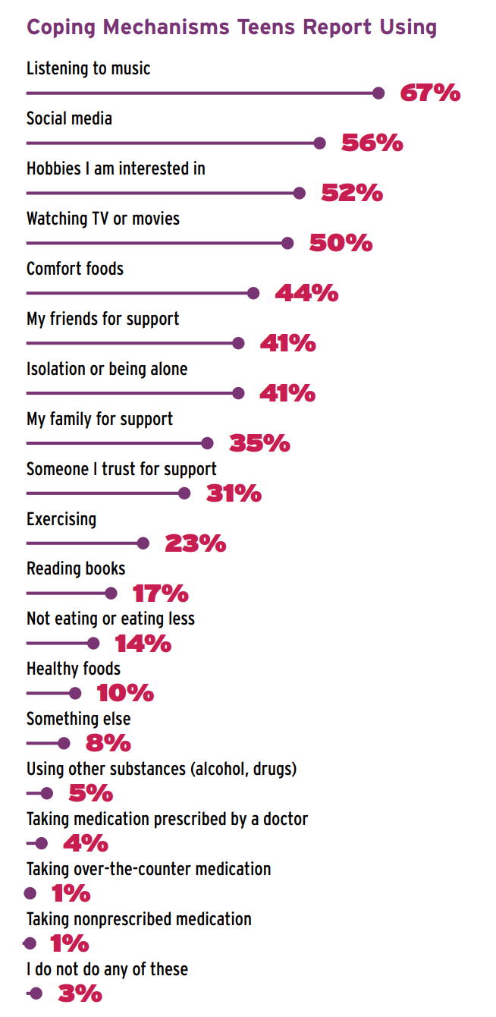
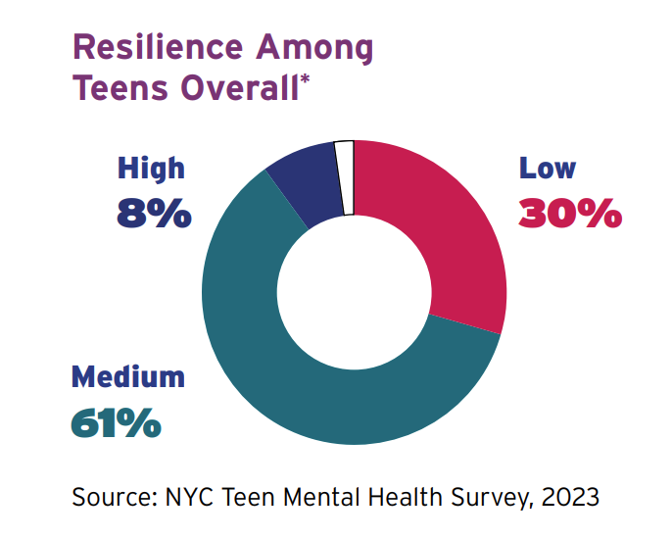
The State of Mental Health in NYC
schools
Between 2011 and 2021, the city's high school students reporting feeling sad or hopeless increased from 27% to 38%
While majority of teens use music and social media as coping mechanisms, 23% of teens reported criticizing themselves a lot and 15% say they blame themselves for a lot of things.
We identify resilience to be a critical measure for the student's ability to bounce back after experiencing stressors or challenges and acknowledge how students may be ill-equipped with negative coping mechanisms.
The teenage years can increase exposure to new and unique stressors as students approach high school.
Notes:
Aaryan

Slide 9
Mental Health in NYCDOE Schools
DOE Mental Health Programs: School counselors, DESSA Screener, Harmony SEL, etc.
"While DOE has shown willingness to confront these issues, many of NY's school children still face a mental health emergency, and schools are not equipped to provide them with support they need." - Comptroller DiNapoli
"Only 1,101 out of 1,524 public schools had at least one social worker; of those schools, 80% did not meet the recommended social-worker-to-student ratio of 1:250. 423 public schools did not have a social worker at all."
-Data collected by DiNapoli's health and safety for schools audit (2022)
Notes:
lamiah

Slide 10
03
Target
Audience
Notes:
lamiah

Slide 11
NYC Guidance Counselors
NYC School Social Workers
Target Audience
Student Wellness Team
High School Students
NYC School Nurses
Notes:
lamiah

Slide 12
04
Design
Process
Notes:
lamiah

Slide 13
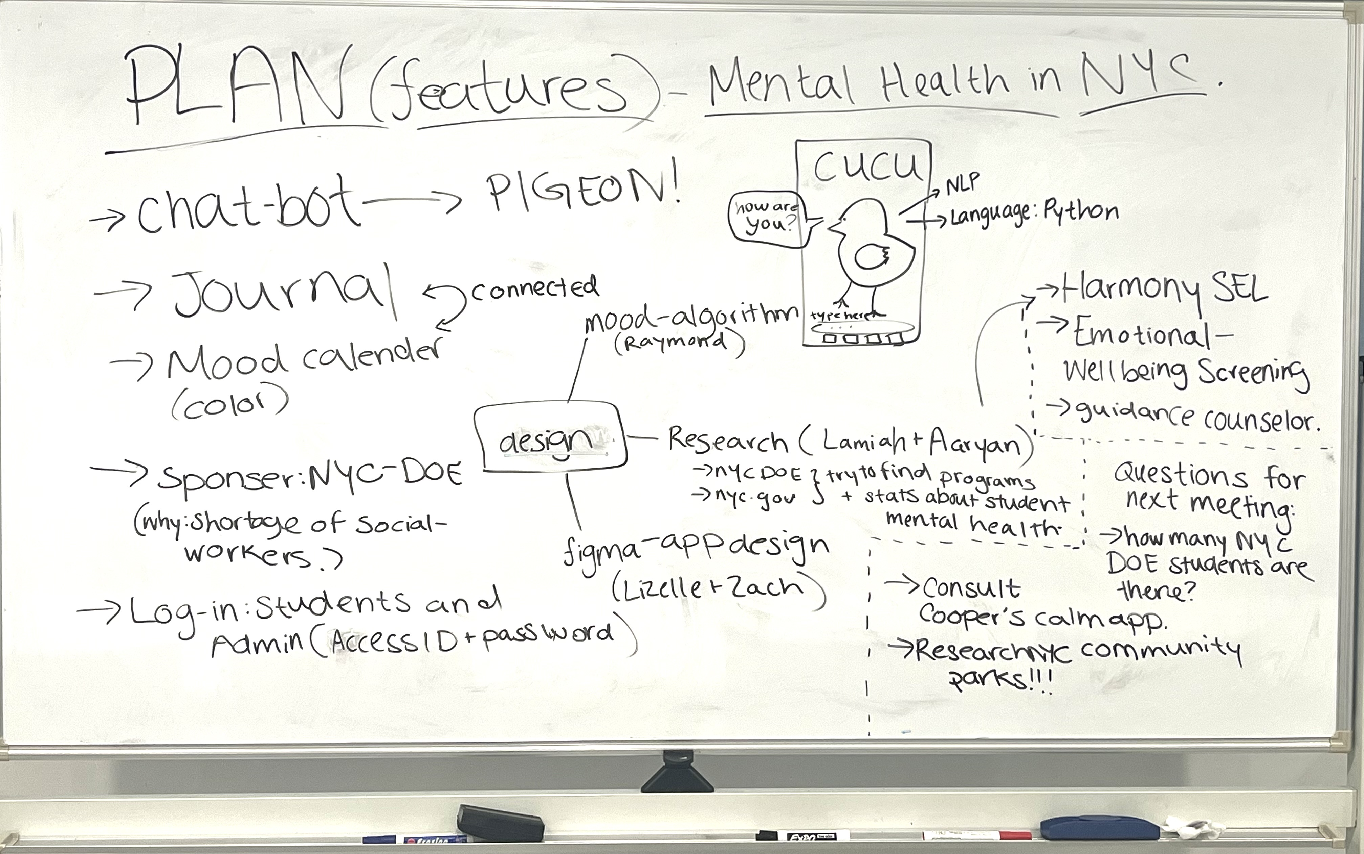
Design Process
01 Brainstorm
02 Research
Desired features.
Algorithms implemented.
Design UI.
NYC-based app.
Investigated nyc.gov sites.
Department of Education programs.
Chat-bot features.
Current mental health apps.
03 Figma
04 Python
Utilized for mapping app features.
Designed virtual companion (CUCU).
(anything else to add)
Created mood-based algorithm.
Incorporated data from (idk what ray did)
Pfizer 2024 | Confidential and Proprietary
Notes:
lamiah

Slide 14

Overview of Solution

Slide 15
05
Mood Classification Algorithm

Slide 16
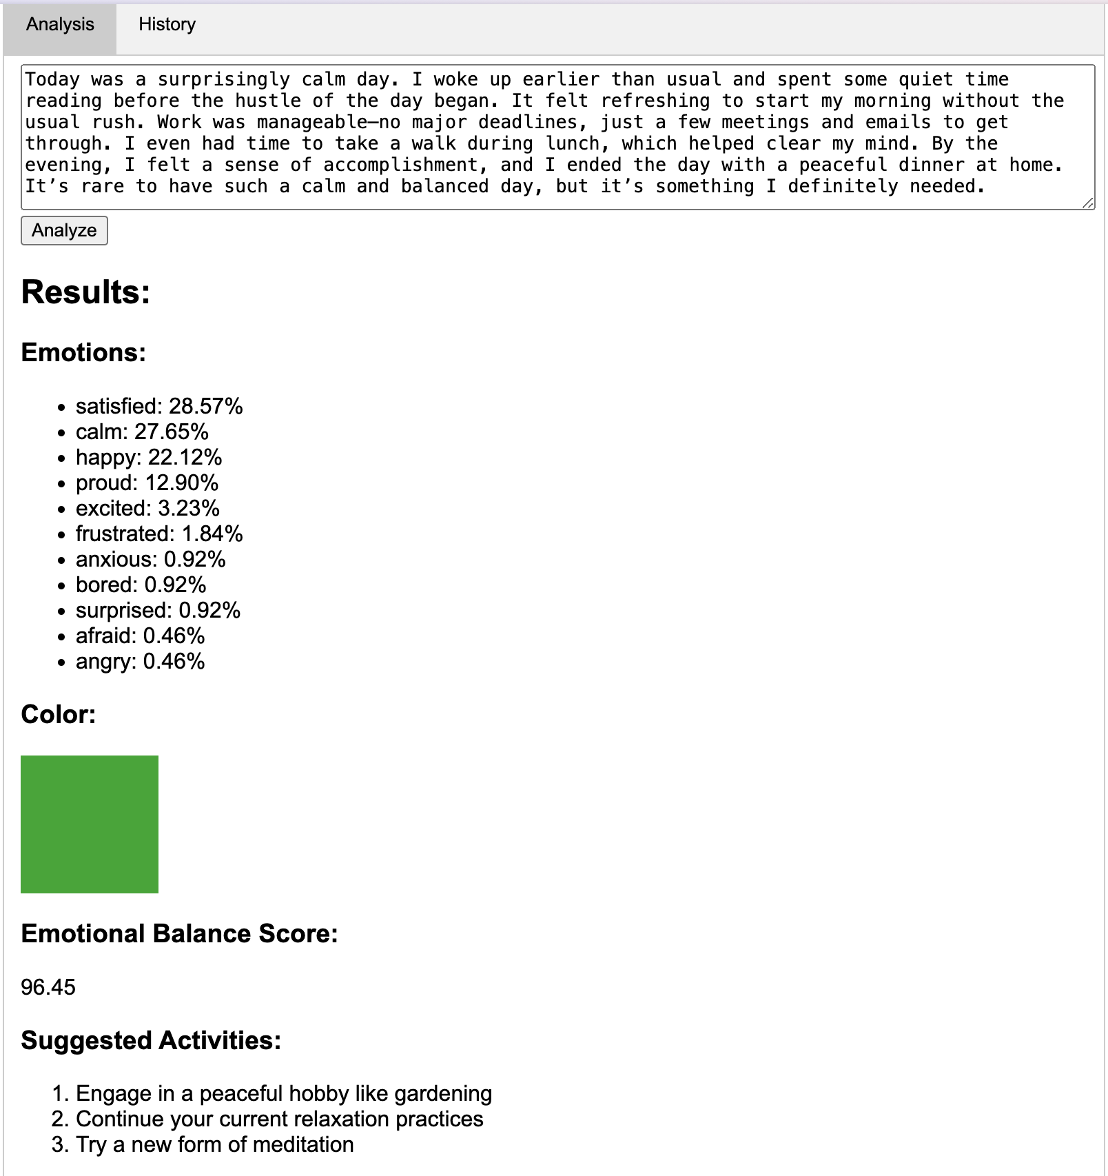
Mood Classifier
The classifier analyzes the text of journal entries using NLP techniques, identifying keywords, phrases, and emotional cues associated with different moods (e.g., "happy," "anxious," "angry").
Each mood is associated with its own color to be used in the CUCU mood journal.
The classifier then suggests mental health activities based on their mood and needs.
Machine Learning Block
Language Embedding
Random Forest Classifier
3. Train Model
Rate Emotions on Custom Metric
Generate Color
Suggest activities based on mood

Slide 17
06
Minimum Viable Product (MVP)

Slide 18
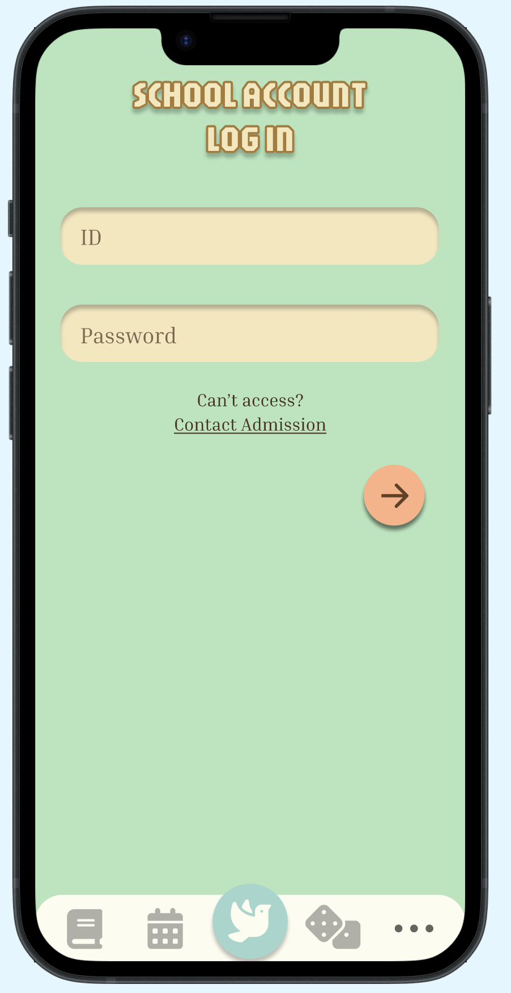
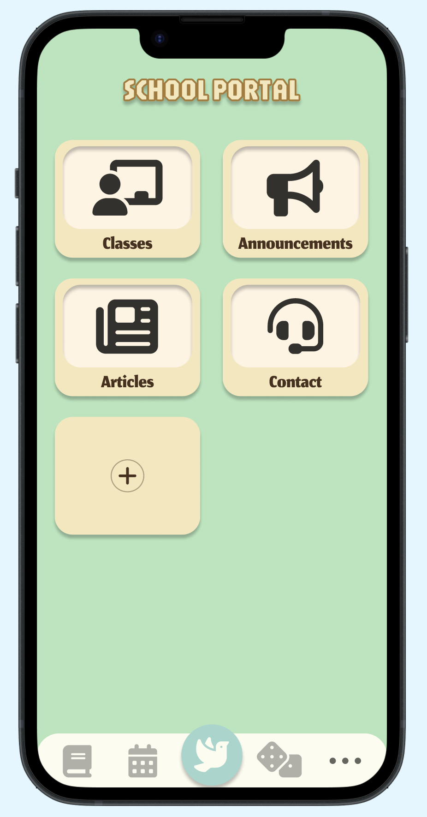
Log-in Page
Student and Admin register or sign-in using their student/access id, followed by their password.
Corresponding credentials transports users to their respective home pages (Student page and Admin Page)

Slide 19
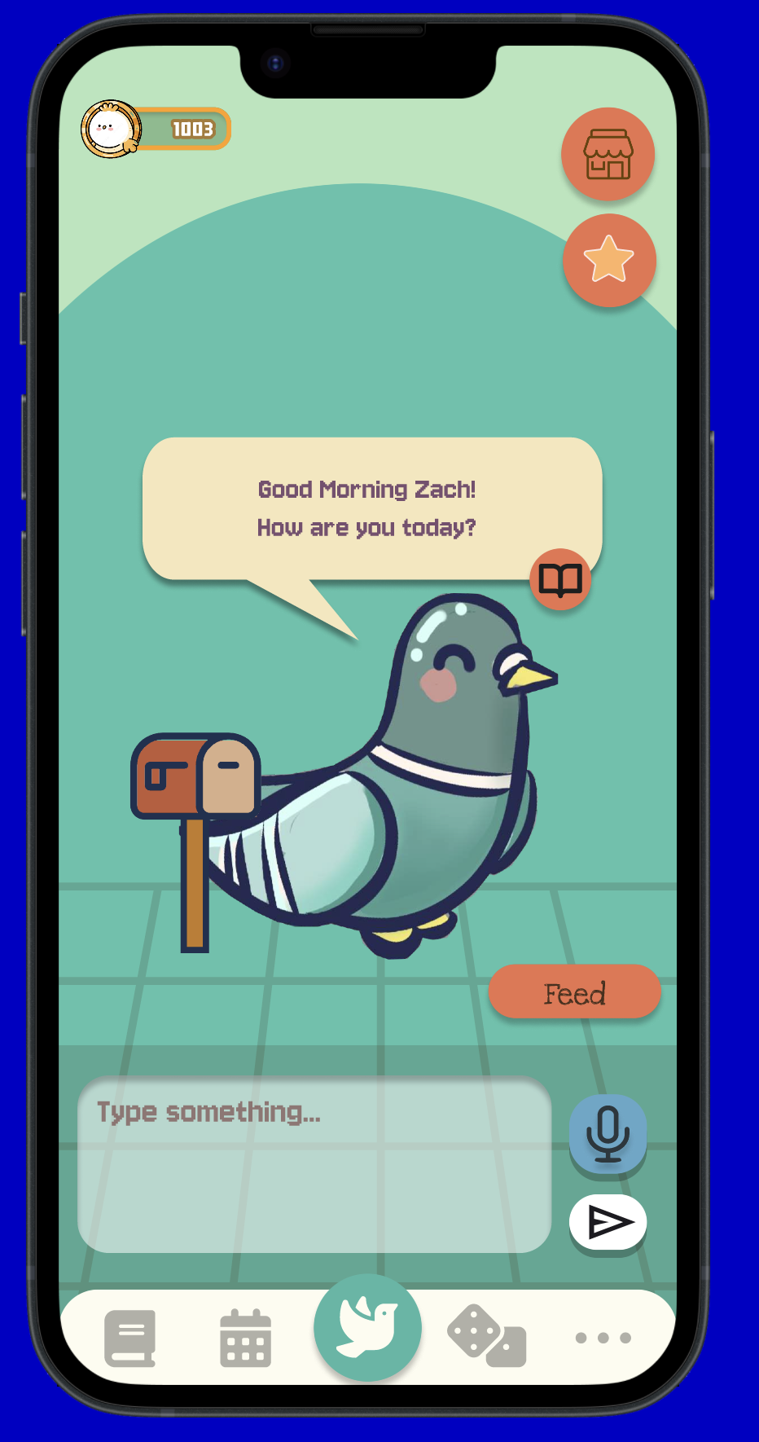
Virtual Companion
Functions
Virtual Companion Default's Name: Cucu
Cucu will ask students questions about their day. Students may reply in both text and audio mode.
Cucu will change its tone and suggest mini-games based on student's interaction.
Student can view conversation history with Cucu.

Slide 20
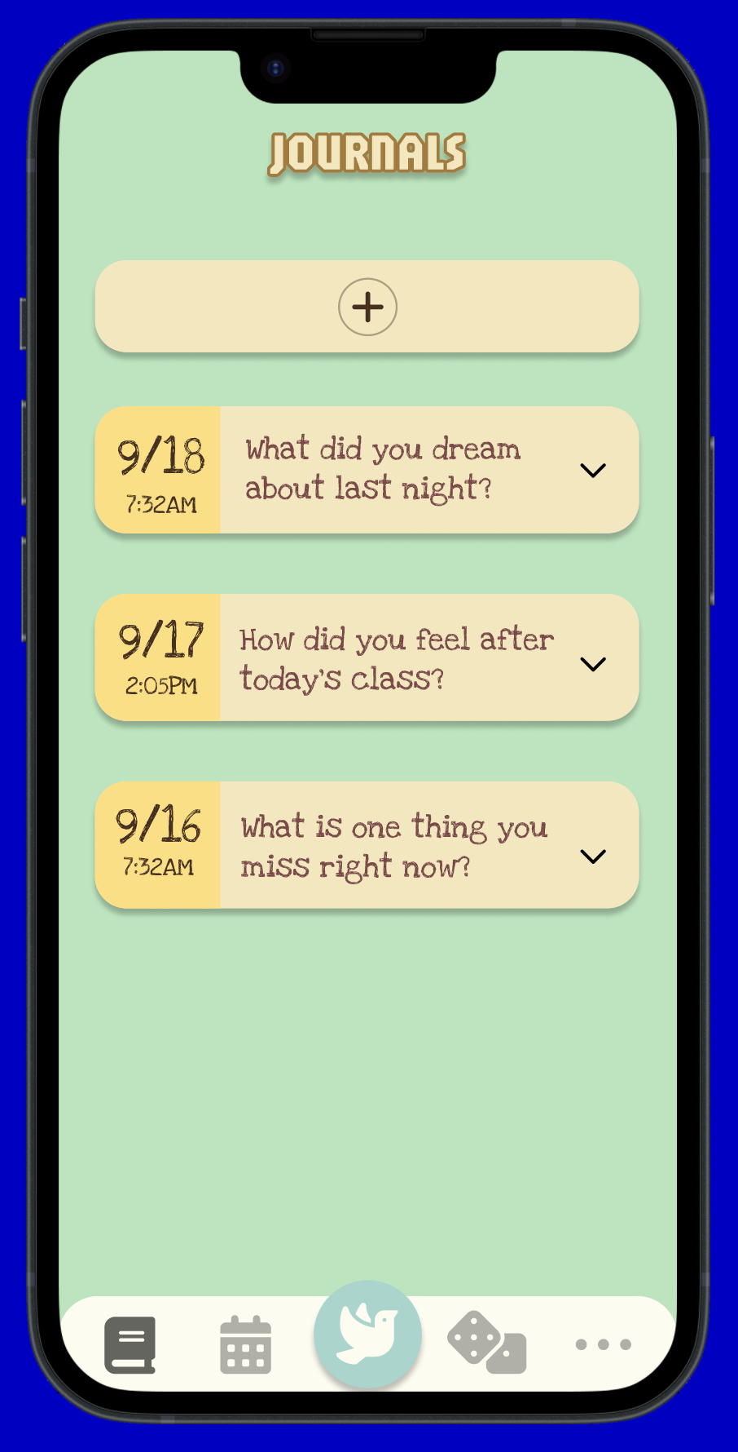
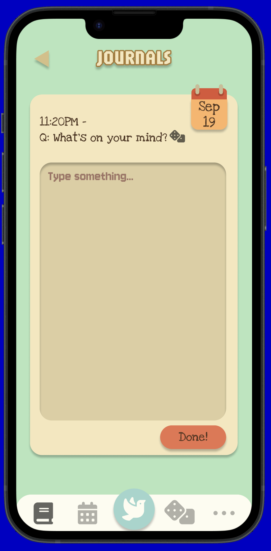
Journal
Functions
Journaling feature randomly assigns students with prompts. Student may shuffle through prompts given to them.
The mood classification algorithm calculates top moods associated with each journal entry.
Past journal entries are saved for the student to reflect on later.
Journal entries will not be shared with Admin accounts.

Slide 21
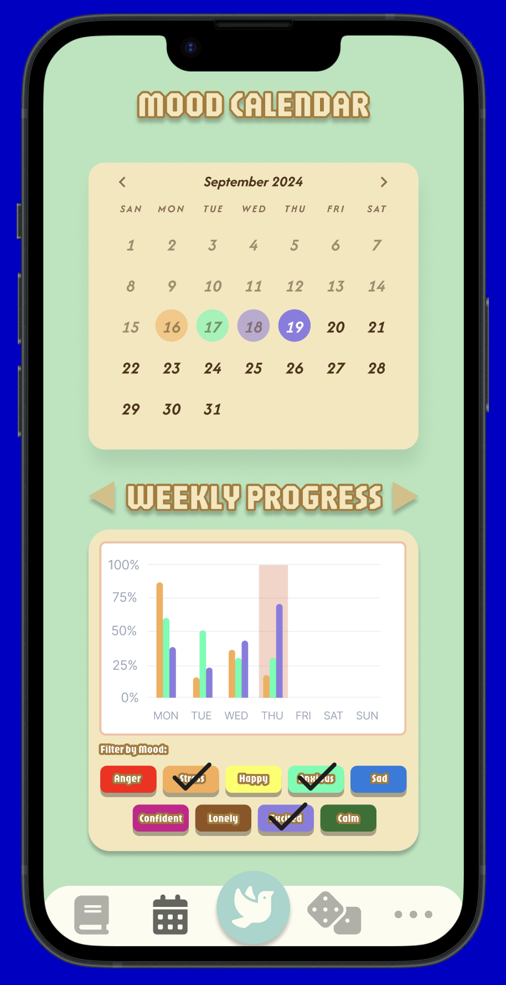
Mood Calendar
Functions
Mood calendar displays the highest correlated moods for each day.
Displays daily and weekly progression of student's moods and can be filtered based on moods specified.

Slide 22
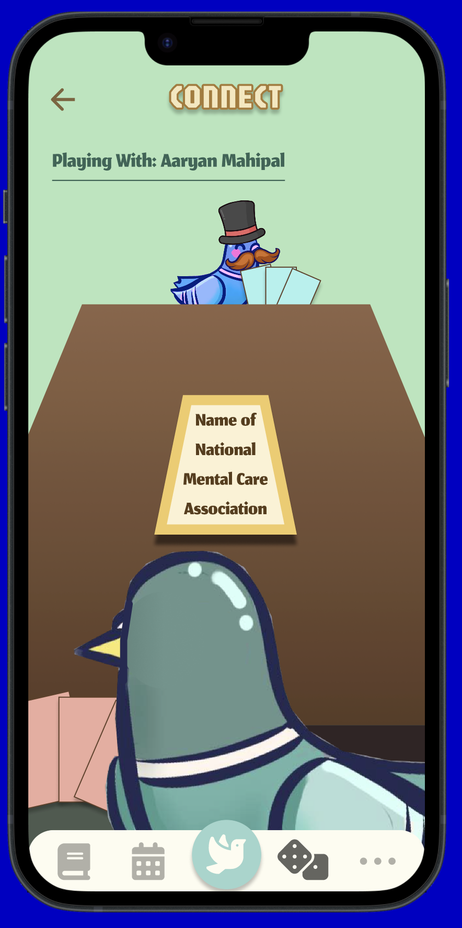
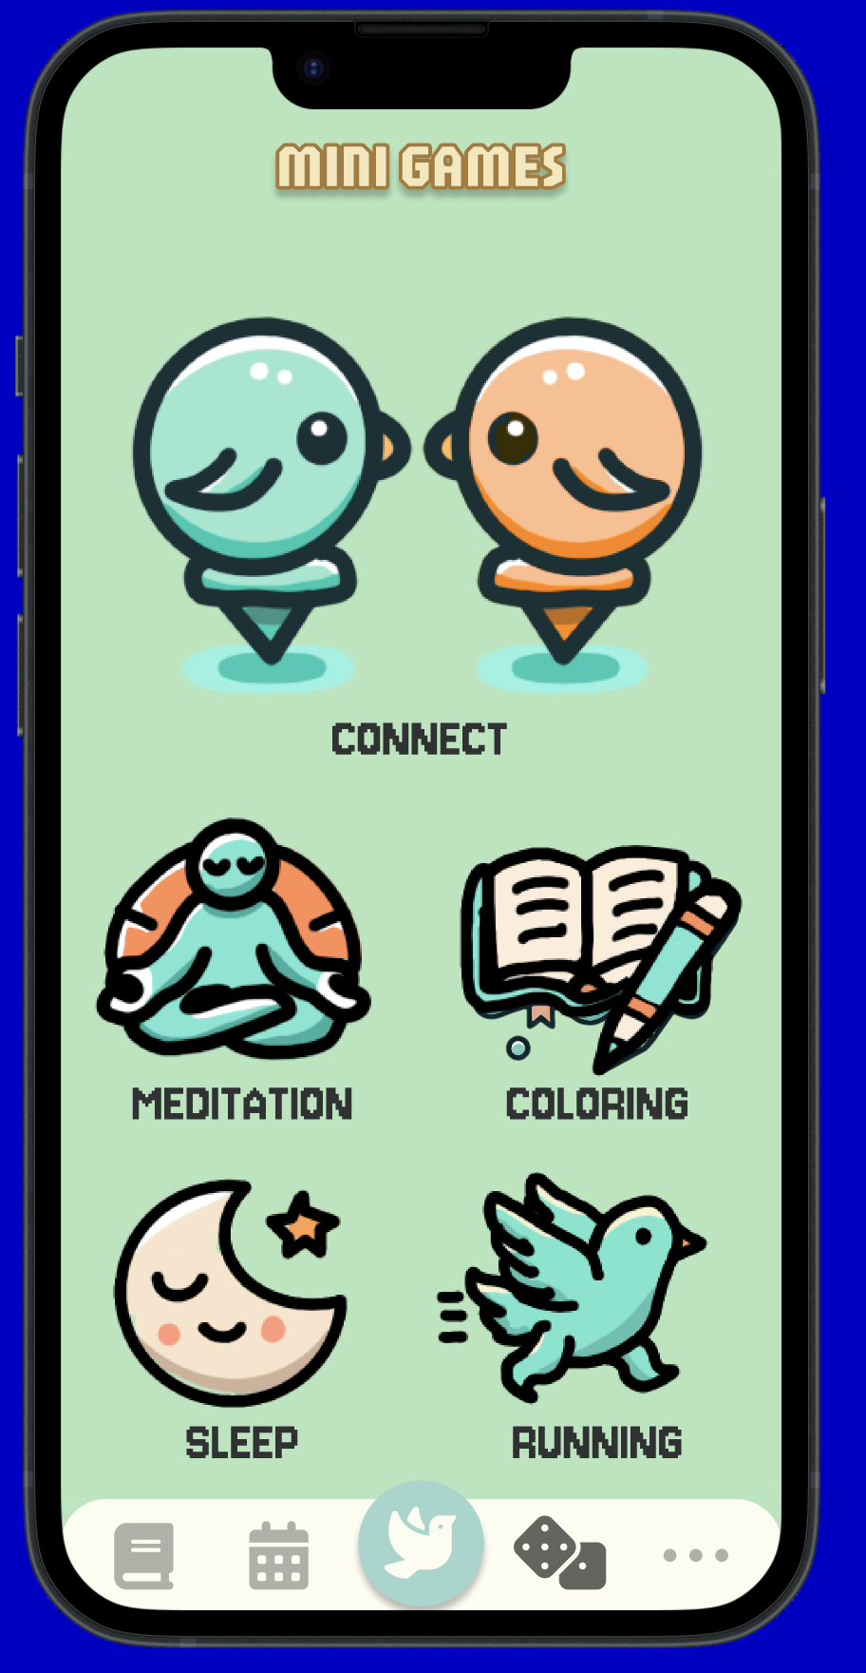
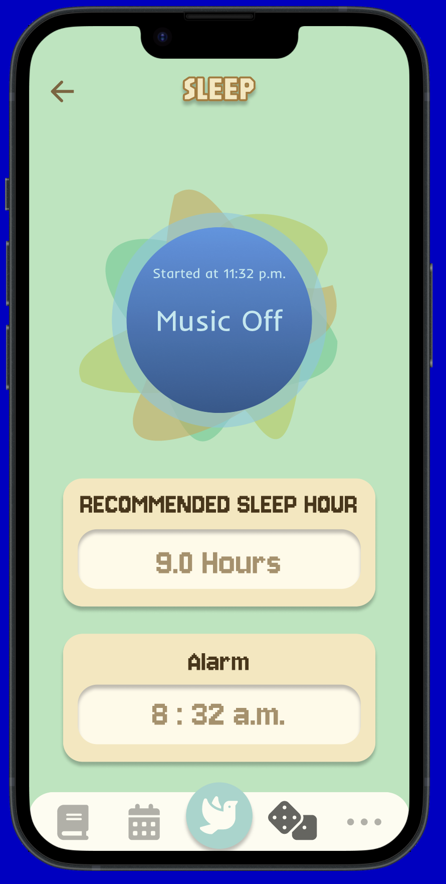
Mini-Games
Connect: Multiplayer games: student can race their pigeons, play slap-"jack" with words of affirmation, mental health trivia, etc.
Meditation: Breathing exercises, visualization, yoga, with reminder to hydrate.
Sleep: Sleep sounds/alarm, with reminders to get 8 hours of sleep.
Running: Stretching/Exercise videos with CUCU, and suggests locations in NYC to hike, swim, and community parks.
Coloring: Relaxing coloring book with numbers, pictures of NYC, etc.

Slide 23
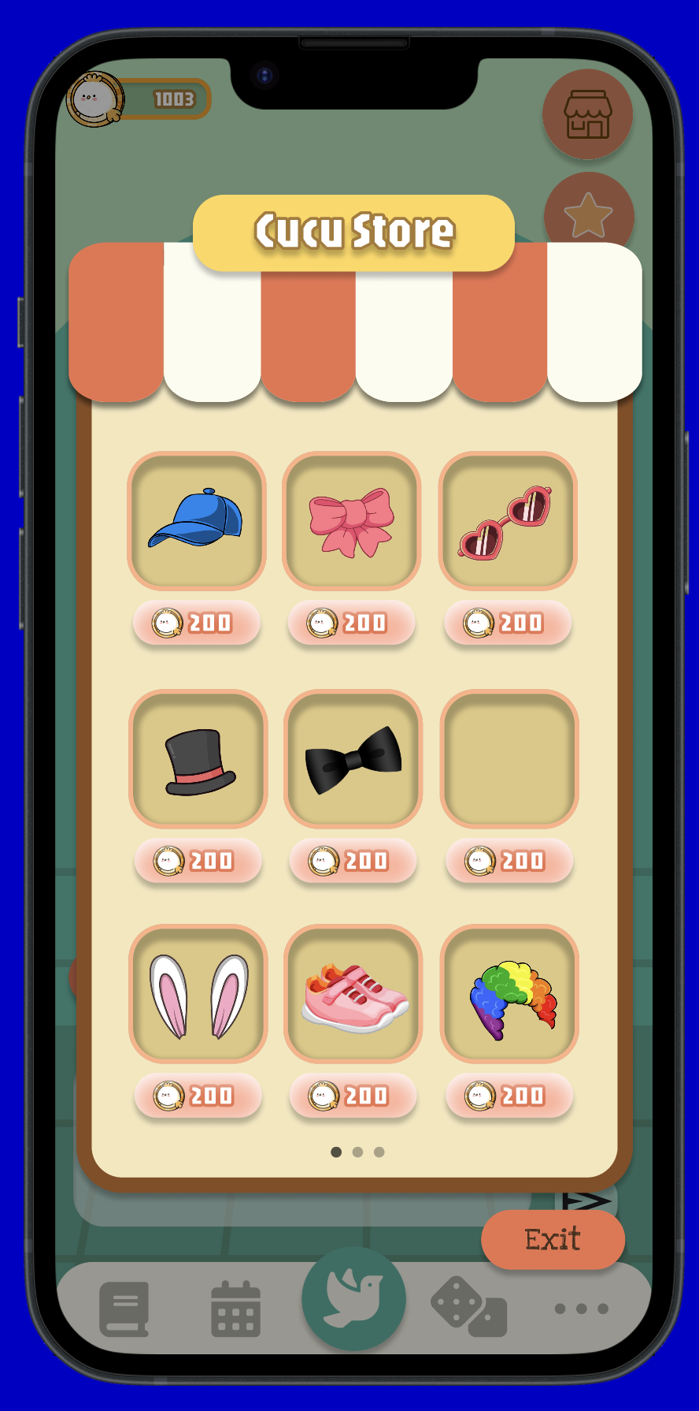

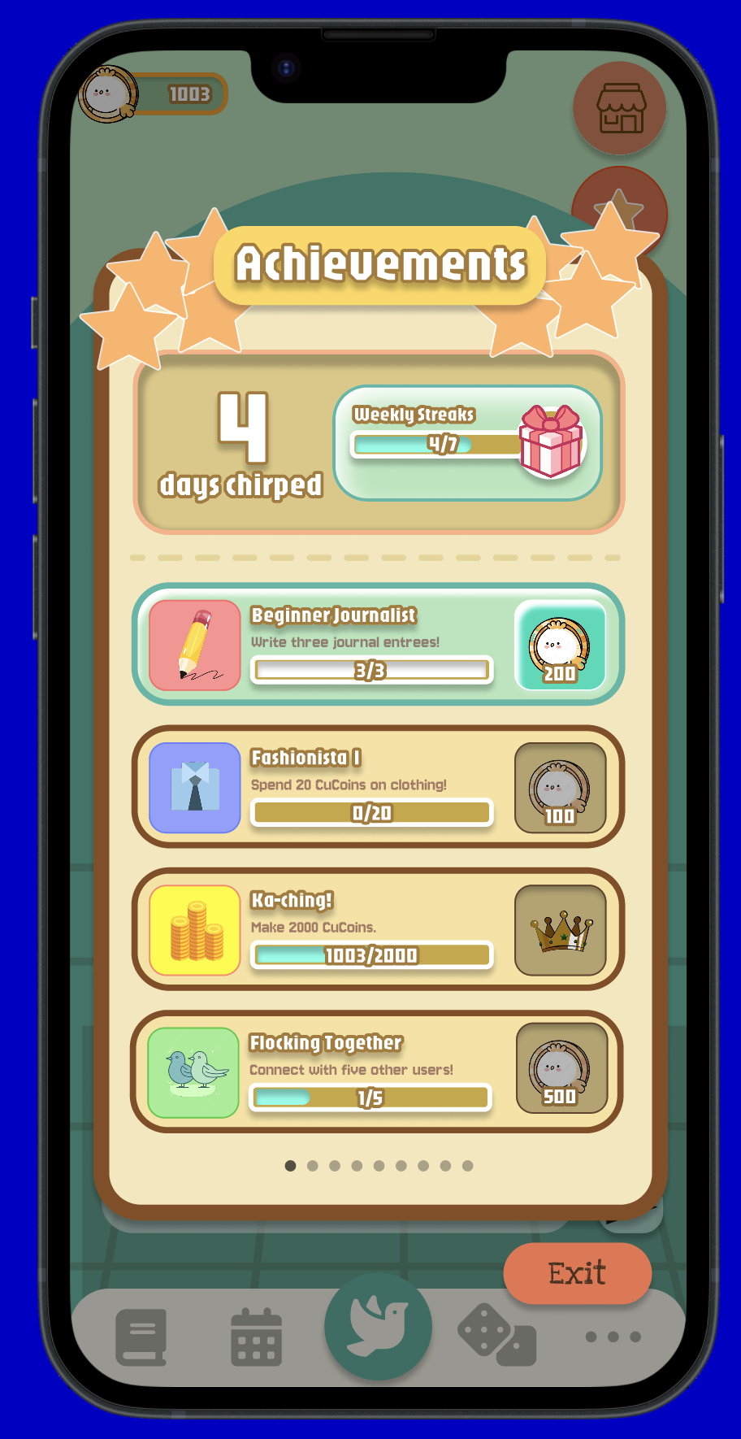
Achievements & CUCU Store
Functions
Examples of Achievements:
Spending 20 CuCoins on clothing.
Writing in your journal three times.
Visiting NYC locations suggested by Cucu.
Students can utilize achievements to collect CuCoins or clothing for Cucu.
Students can see the number of days they have played with Cucu in a row. If they talked with Cucu for seven days in a row, they receive a gift for their pigeon companion!

Slide 24
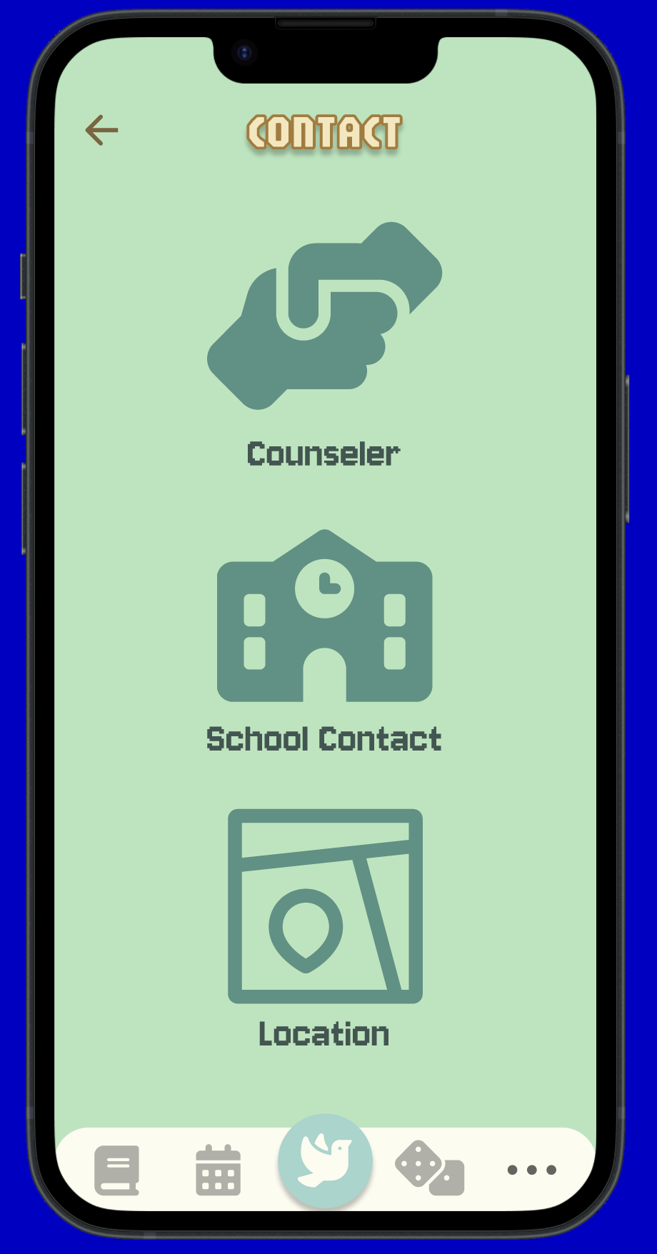
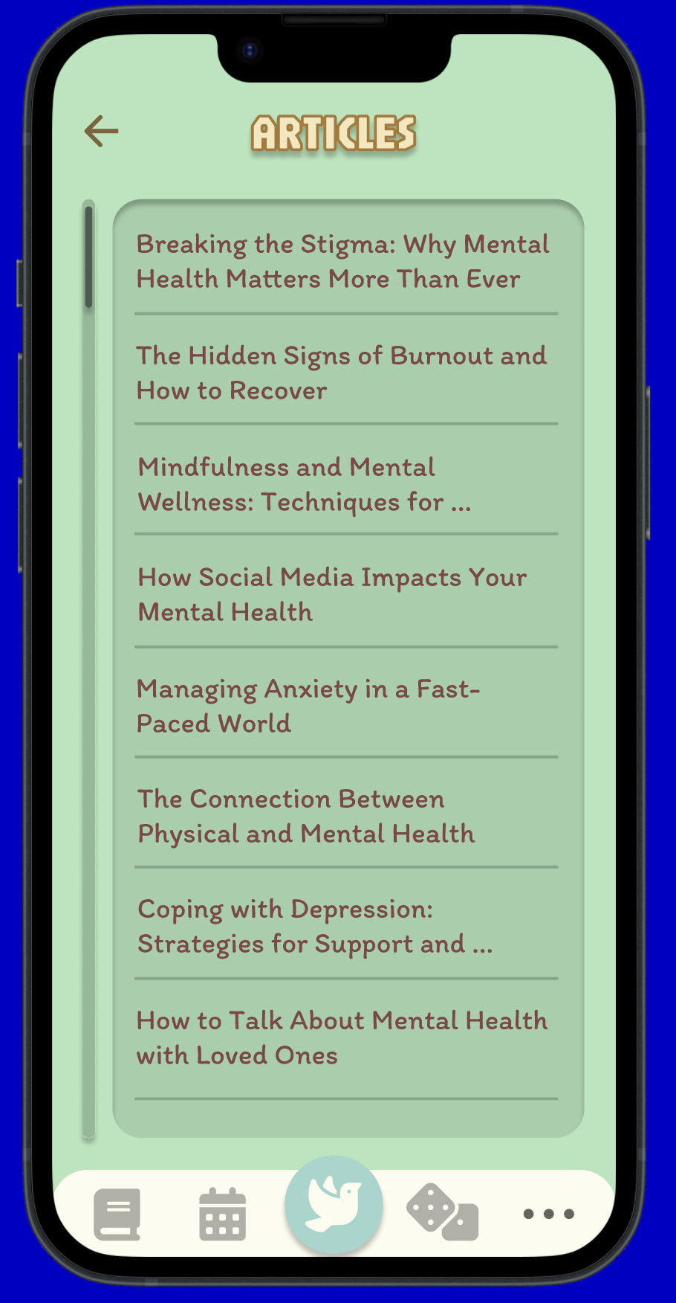
Contact + Articles
Functions
Through contact, students can:
Message their school's Wellness Support team through the app's chat feature.
Directly contact the school.
Find nearby areas to seek necessary help.
Students can access articles regarding mental health activities.

Slide 25
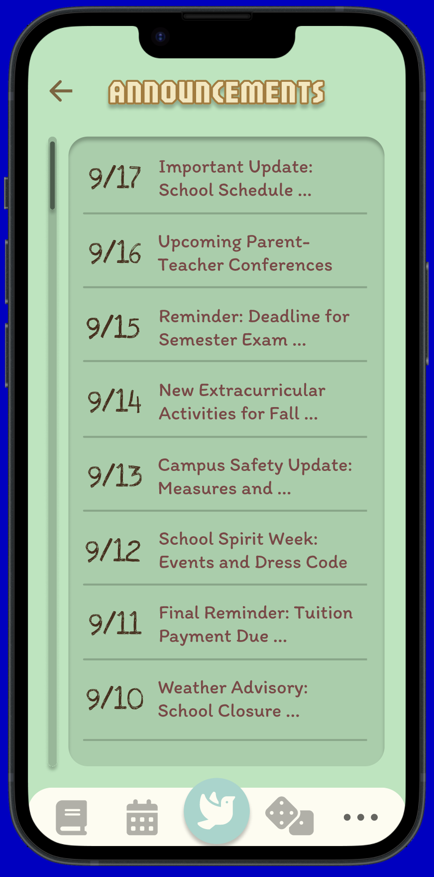
Admin: Announcements
Functions
If the user is a Wellness Support member, they can send announcements to the team and students.
CUCU will send notification on device. If user is on app's home page, message will appear on screen.
When message is exited out, announcement will be recorded in the "mailbox.“
User can view past announcements in their history.

Slide 26
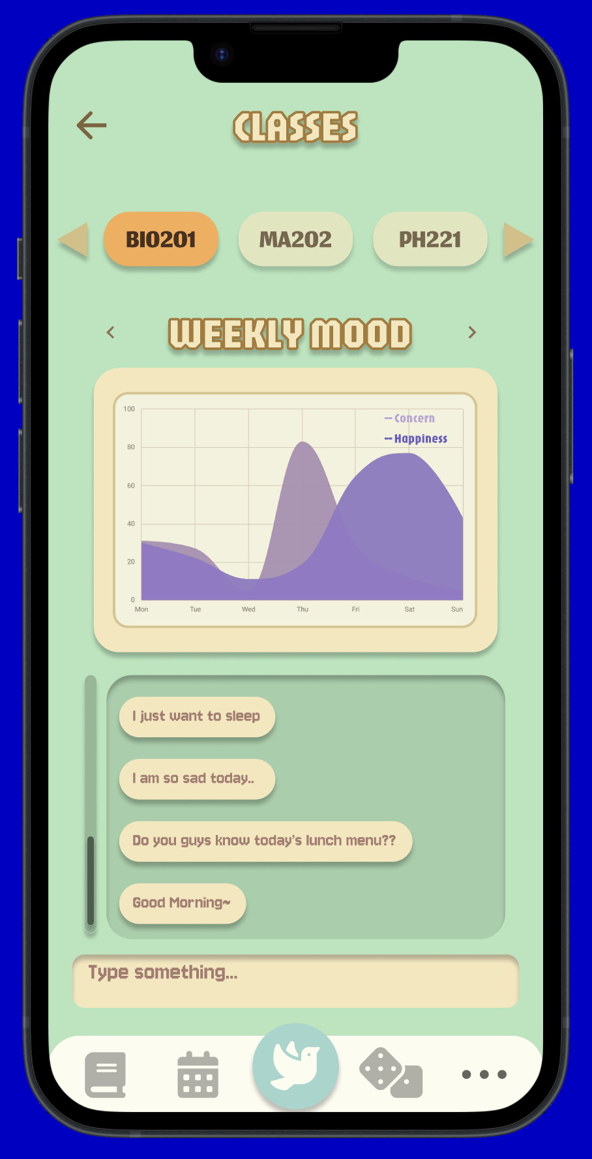
Class Divider
Functions
Admin can view student's moods, with data organized by each class.
Each student's mood is sorted from "most concerning" to "least concerning" via graphical model.
Each class will have a chat feature with their respective social worker.

Slide 27
07
Commercial
Viability

Slide 28
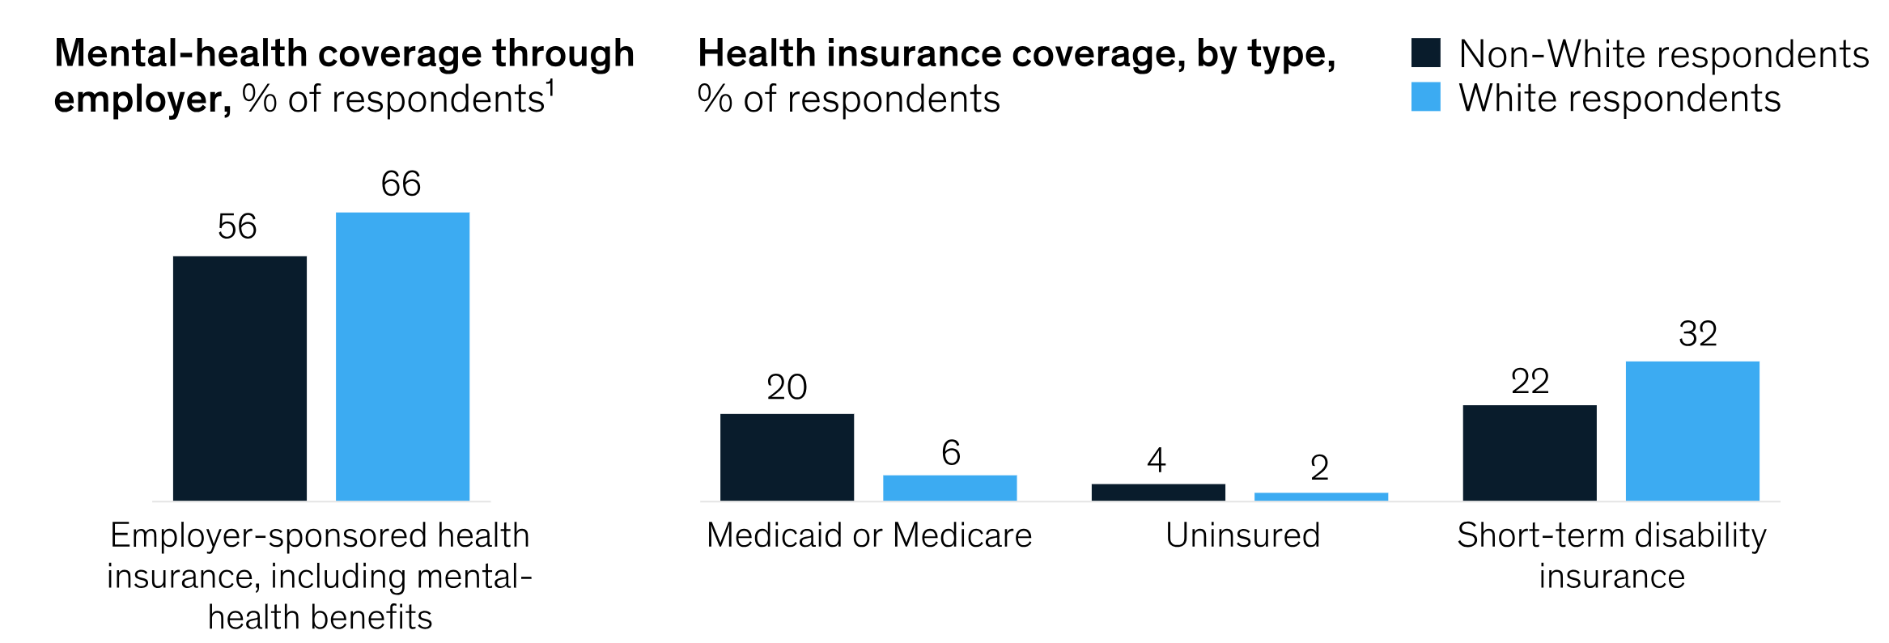
Commercial Viability
In 2022-2023, there were ~1.05 million students registered in the NYC school system, the largest school district in the United States.
While the number of students in DOE schools have only increased by ~1%, it is a sufficiently large and fragmented market for digital mental health services.
Why should the DOE care about this? As a state, NY spends more on behavioral health (BH) including both mental health disorders and substance abuse than almost all other US states ($196 more a year per person than the national average). This is while only 25% of NY residents have a BH-condition while the national average stands at 27%.
Despite NY's above-average spending, it ranks among the bottom-half of all states in some BH metrics, including the proportion of adults, teens, and children with depression who did not receive treatment in 2021.
"Non-White respondents report having lower rates of employer-sponsored health coverage, including mental health benefits"
Notes:
The importance of BH within overall well-being and economic health is an evolving focus of healthcare research. BH conditions have a disproportionate impact on overall healthcare spending: around 60 percent of overall healthcare spending is attributable to the roughly one-quarter of the population diagnosed with BH conditions. Unaddressed BH conditions can also affect productivity in the workplace and mortality rates, in addition to having a pronounced effect on an individual’s emotional and social well-being

Slide 29
08
Future Steps

Slide 30
Future Steps
Estimated Timeline ~ 3 years
Winter
2024
Summer
2025
Winter
2026
Summer
2026
Winter
2027
Stage 1: Chat-Bot Modification
Stage 2: Beta Testing
Stage 3: Launch
Stage 4: Iteration
Stage 5: Growth
Consider incorporating transformers for CUCU's longer and more successful monologues.
After chat-bot modification, we will beta test the effectiveness of the product with a focus group
Launch with select schools in Brooklyn and Queens, spend time on-boarding and educating students and teachers on best practices.
Iterate on feedback received and constantly push to innovate and expand the market
Based on feedback, CUCU will expand to other NYC schools, including boarding and private schools.

Slide 31
Works Cited
“Addressing the State of Behavioral Health in New York City.” McKinsey & Company, 16 Feb. 2022, www.mckinsey.com/industries/public-sector/our-insights/addressing-the-state-of-behavioral-health-in-new-york-city. Accessed 12 Sept. 2024.
“The State of Mental Health of New Yorkers.” NYC.Gov, www.nyc.gov/assets/doh/downloads/pdf/mh/state-of-mental-health-new-yorkers.pdf. Accessed 12 Sept. 2024.
Bamberger, Cayla. “NYC Schools ‘not Equipped’ to Support Student Mental Health, State Audit Finds.” New York Post, 19 Aug. 2022, nypost.com/2022/08/18/nyc-schools-not-equipped-to-support-student-mental-health-audit/. Accessed 12 Sept. 2024.
“DiNapoli: NYC Department of Education Must Do More to Combat Mental Health Crisis among Youth.” Office of the New York State Comptroller, 18 Aug. 2022, www.osc.ny.gov/press/releases/2022/08/dinapoli-nyc-department-education-must-do-more-combat-mental-health-crisis-among-youth. Accessed 12 Sept. 2024.
“Youth Mental Health and Social Media Usage.” Youth Mental Health and Social Media Usage - NYC Health, www.nyc.gov/site/doh/health/health-topics/youth-mental-health-and-social-media.page#:~:text=In%202021%2C%2038%25%20of%20the,the%20past%20year%20in%202021. Accessed 12 Sept. 2024.

Slide 32
Thank You!

